Slide 1
BANKING APPLICATION
P.PRIYANKA
20216139
EONFWL45668

Slide 2
ABSTRACT
program accepts the number of customers we need to add and adds the customer and account details accordingly. Further, it displays the series of menus to operate over the accounts.
The series of menus displayed are as follows:
Display all account details
Search by account number
Deposit the amount
Withdraw the amount
Exit

Slide 3
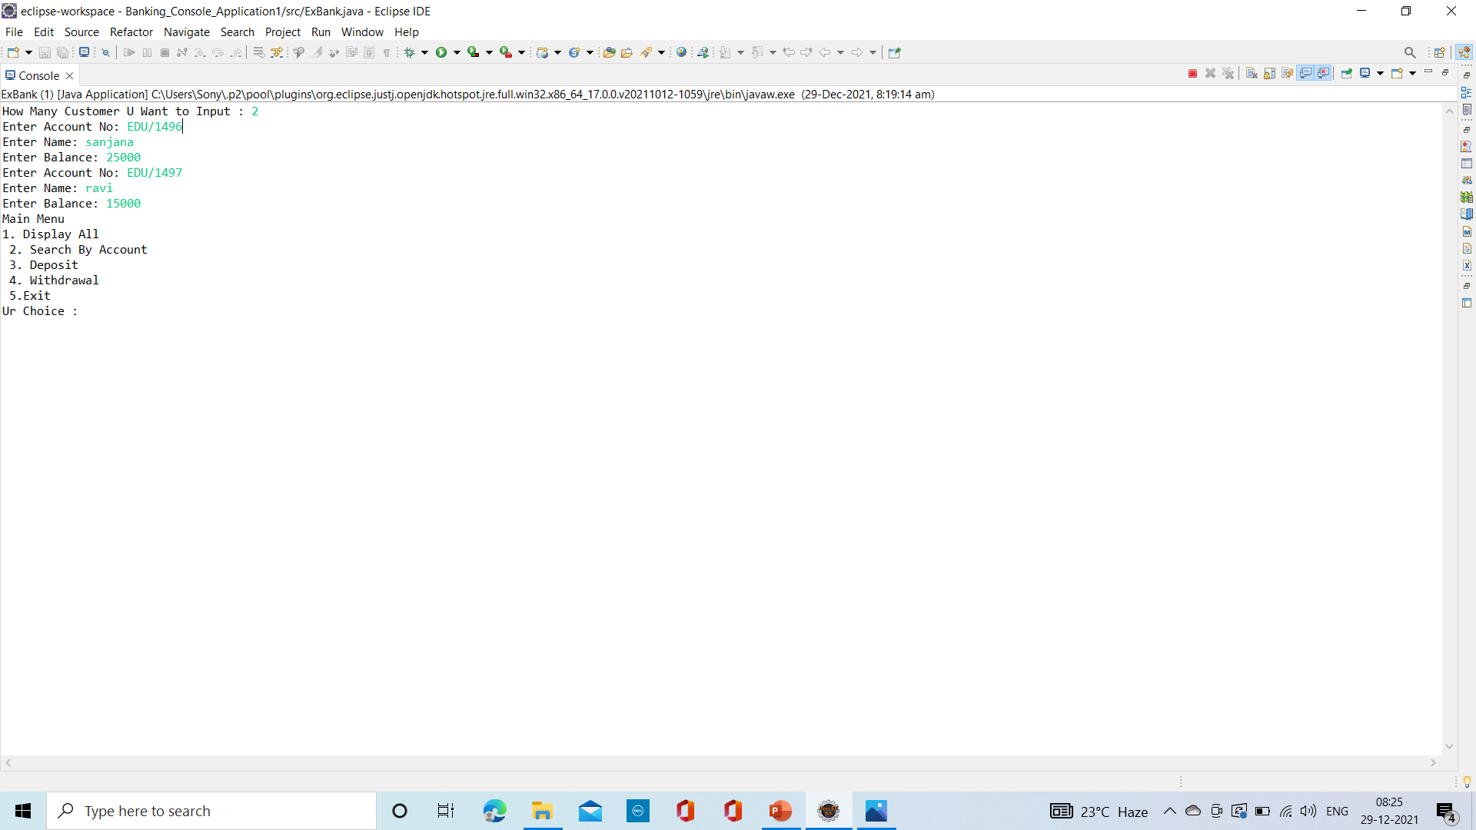
OUTPUT SCREEN

Slide 4
THANK YOU

